Slide 1

Spotify Data Analysis
Deepika Awasthi, Maria Lara, Tanner Lievois

Slide 2

Summary
How Artists Popularity is defined?
Genre
Audio Features
Artists Followers
Total Songs released in a Year
Findings

Slide 3
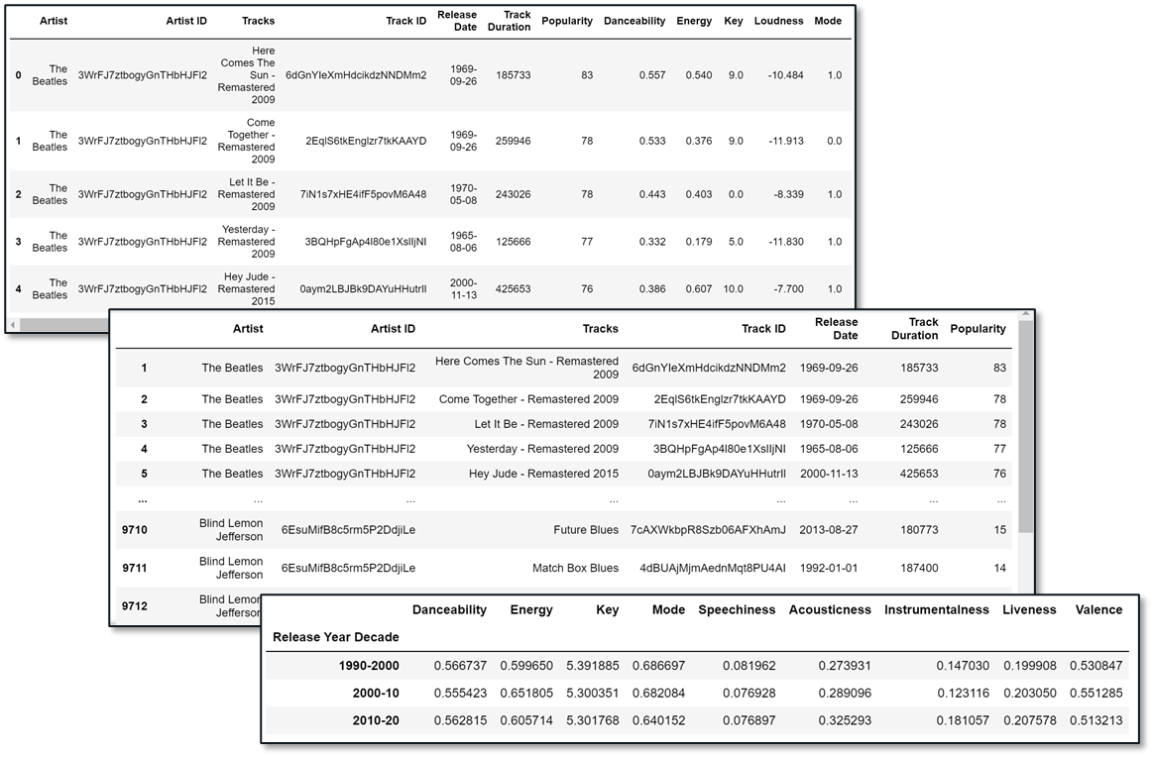
Data Clean up & Exploration
Spotify API, Spotypy Library.
Seeking Artists Names & ID, Tracks ID.
Dropping “NaN” values.
“Popularity & Decade” bins.
Filtering/sorting (loc, iloc).
CSV files.

Slide 4
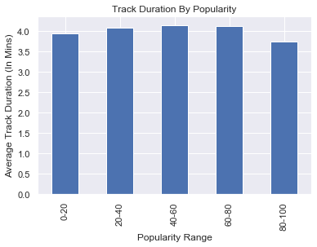
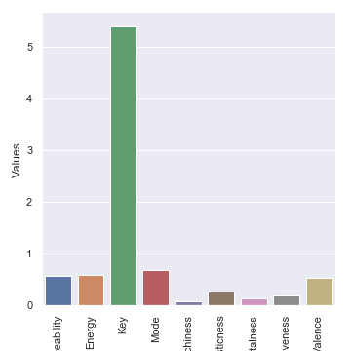
Data Analysis
Does track’s duration affect artists popularity?

Slide 5
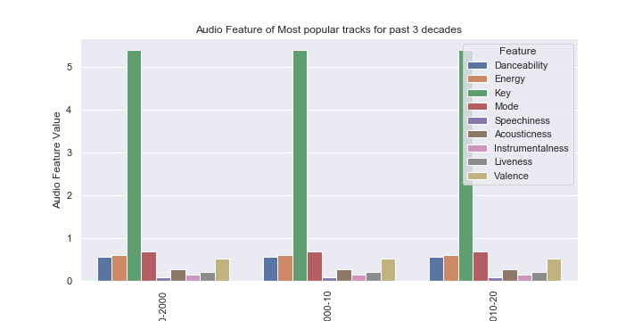
Data Analysis
Audio Features Analysis

Slide 6
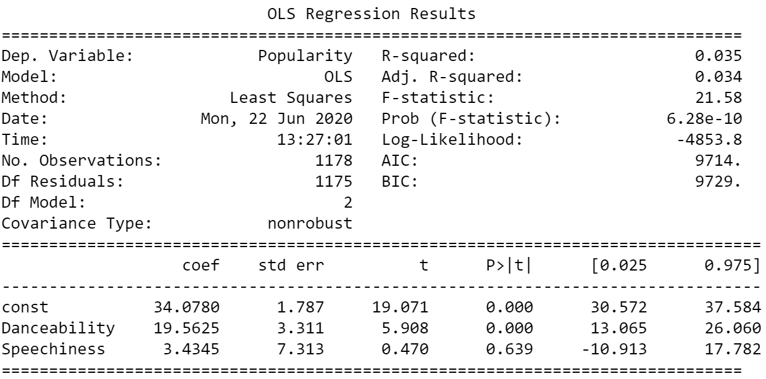
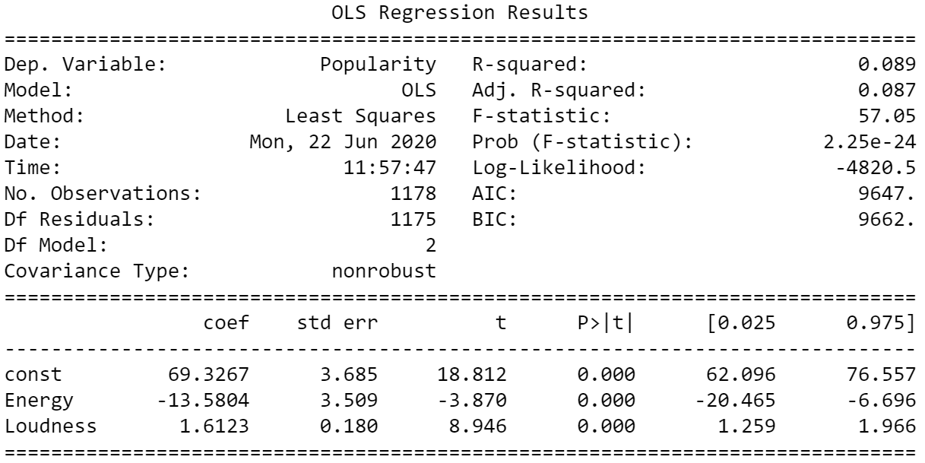
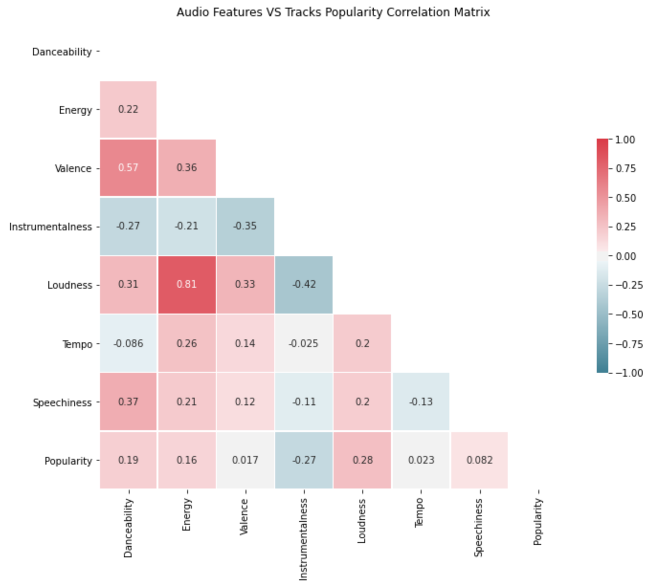
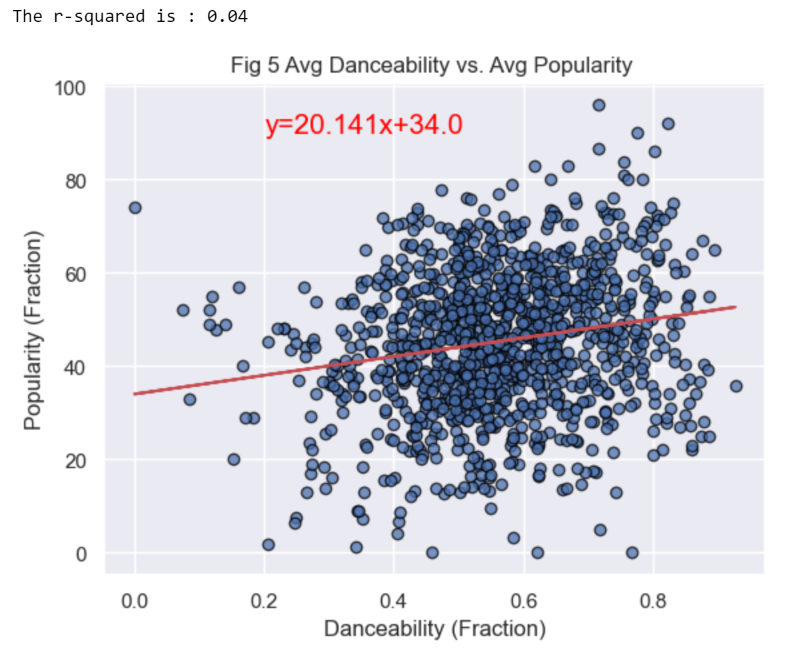

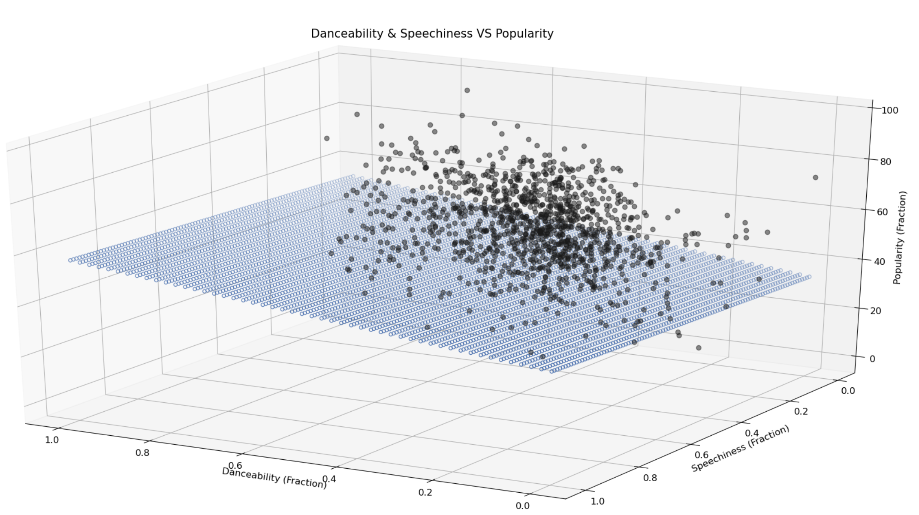
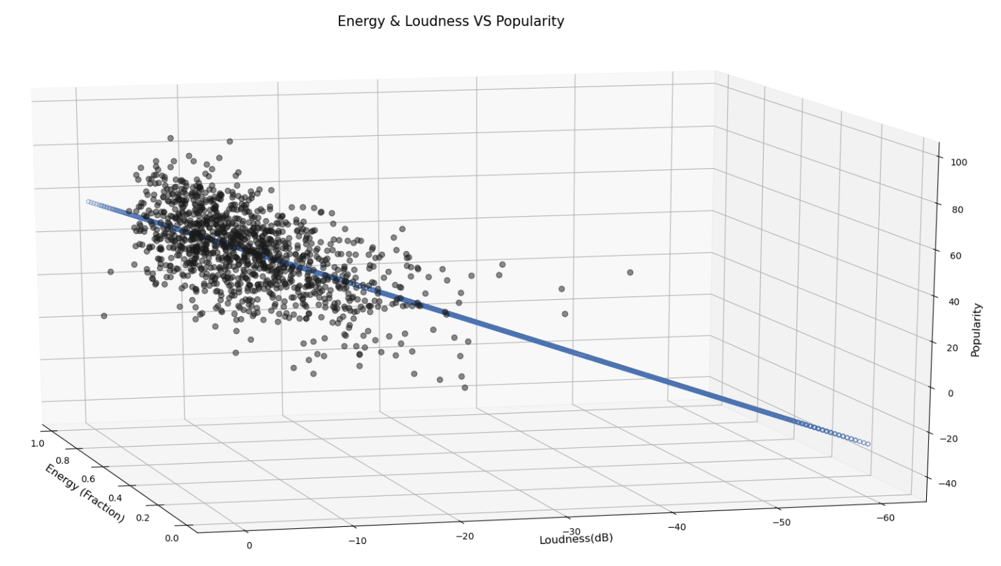
Data Analysis
Does Tracks Features (danceability, energy…) affect songs popularity? Any relationship?
Multiple Linear Regression
Instrumentalness
Loudness
Danceability
Energy
Source: An Introduction to Statistical Learning, James G., Witten D., Hastie., Tibshirani R.

Slide 7
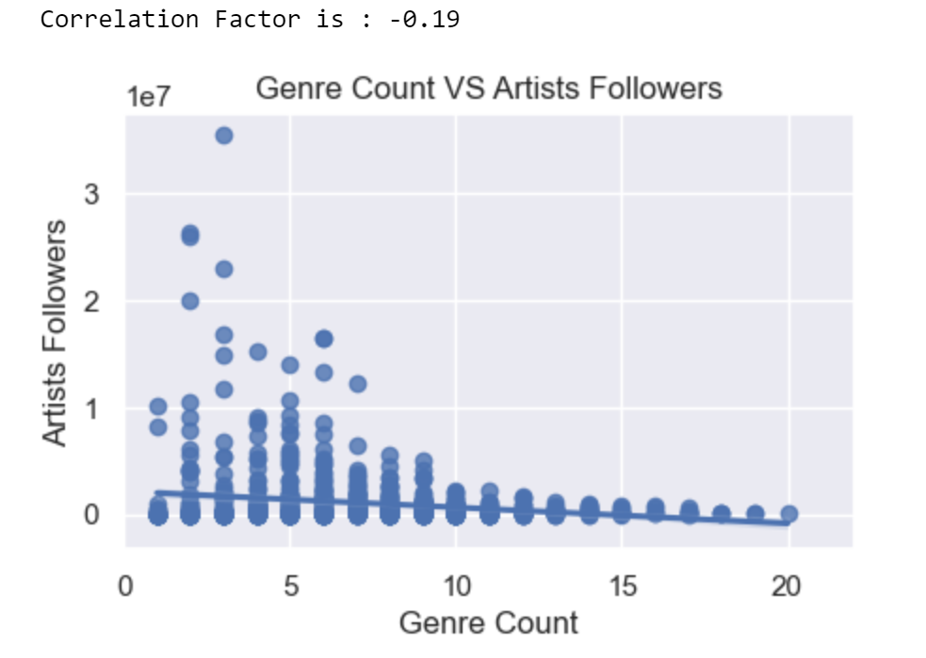
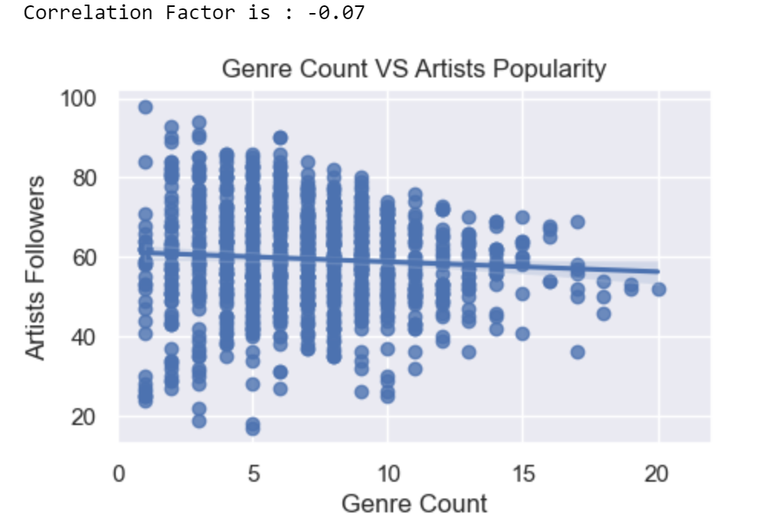
Data Analysis
The higher Genre Count per artist, the higher Artist Popularity and Artist Followers?

Slide 8
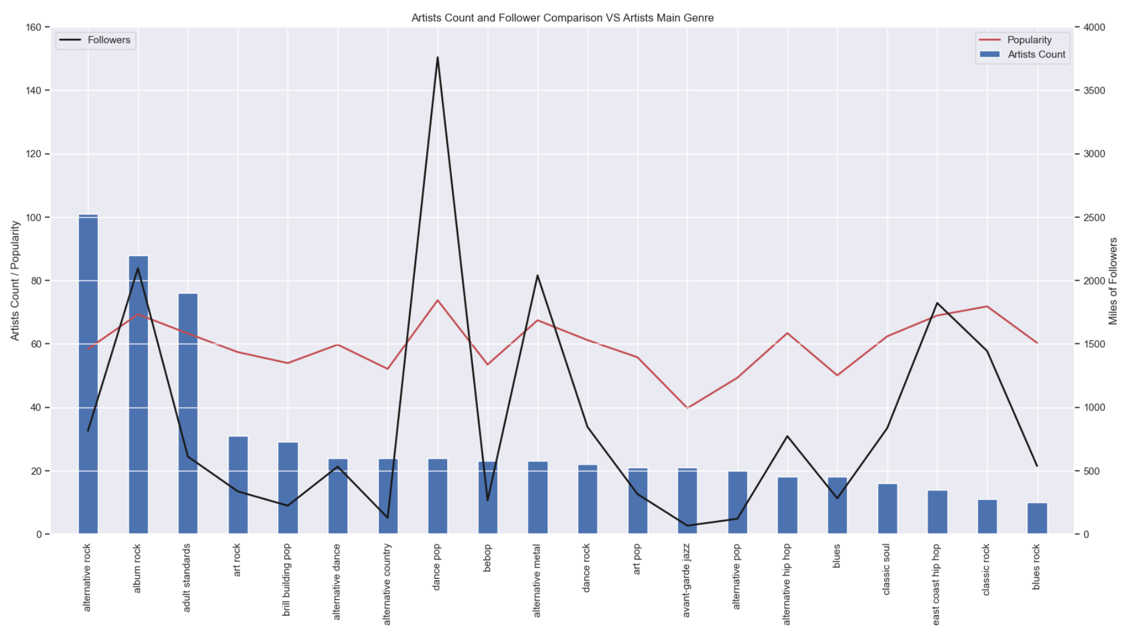
Data Analysis
Main Genre per Artist and the relationship with their Popularity and Followers

Slide 9
Discussion
Artist popularity it’s a subjective matter. Audio Features are not key elements to define the tracks popularity.
No matter how many genres an artist have, “people” is the variable that defines tracks popularity, and thus, artists popularity.
Track Duration Analysis
XYZ

Slide 10
Post Mortem
Discuss any difficulties that arose, and how you dealt with them
Discuss any additional questions that came up, but which you didn't have time to answer: What would you research next, if you had two more weeks?
Group A
Task 1
Task 2
Group B
Task 1
Task 2
Group C
Task 1
Task 2
Group D
Task 1
Task 2

